Slide 1

How to improve our sales?

Slide 2
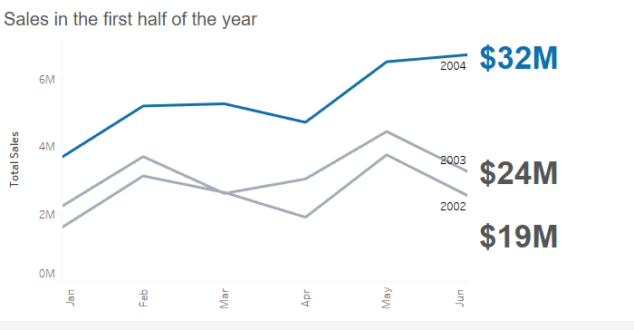
Since last year we increased our sales by 33%.
How to keep success?

Slide 3
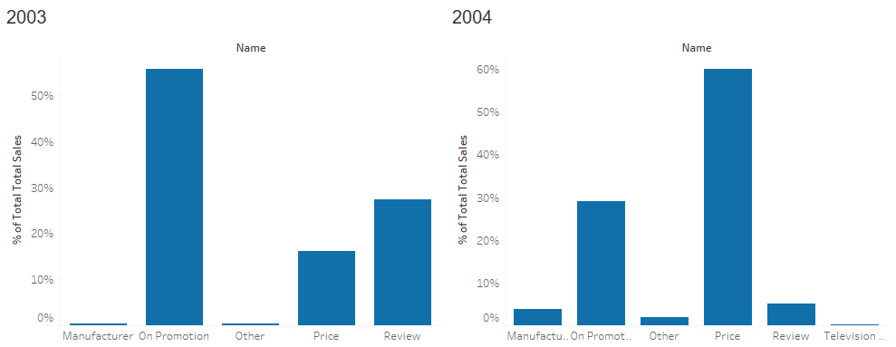
What is the reason?

Slide 4
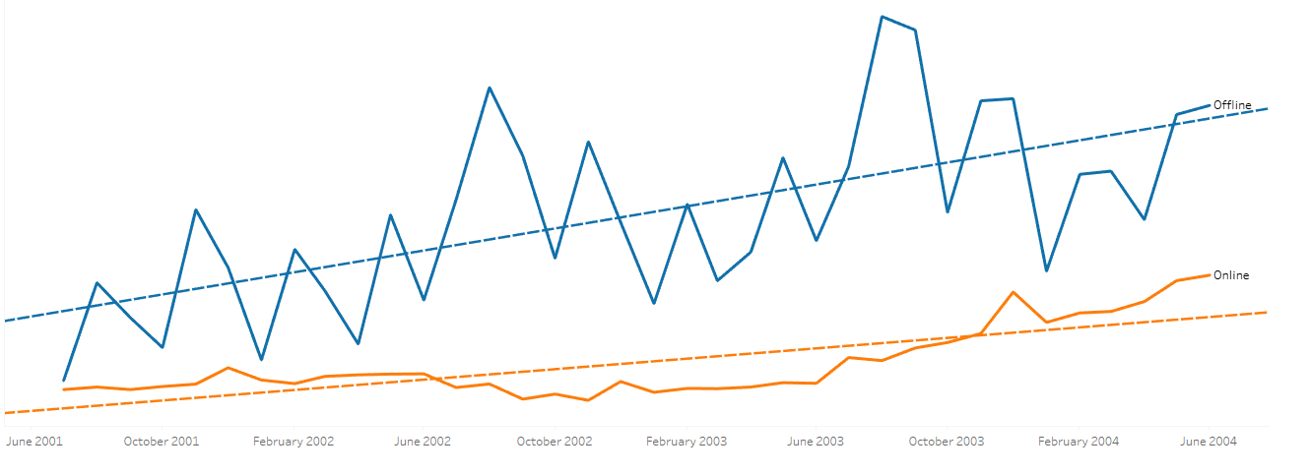
Focus on online or offline sales?

Slide 5
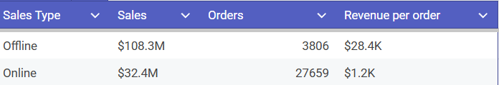
Online or Offline Sales stats.

Slide 6
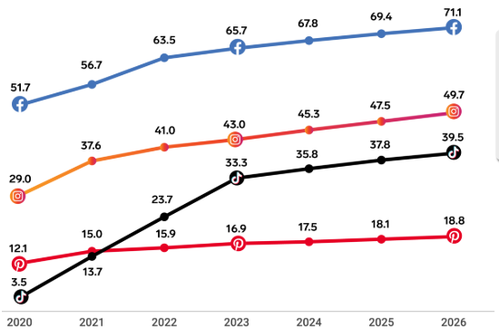
Social media advertising and short videos

Slide 7
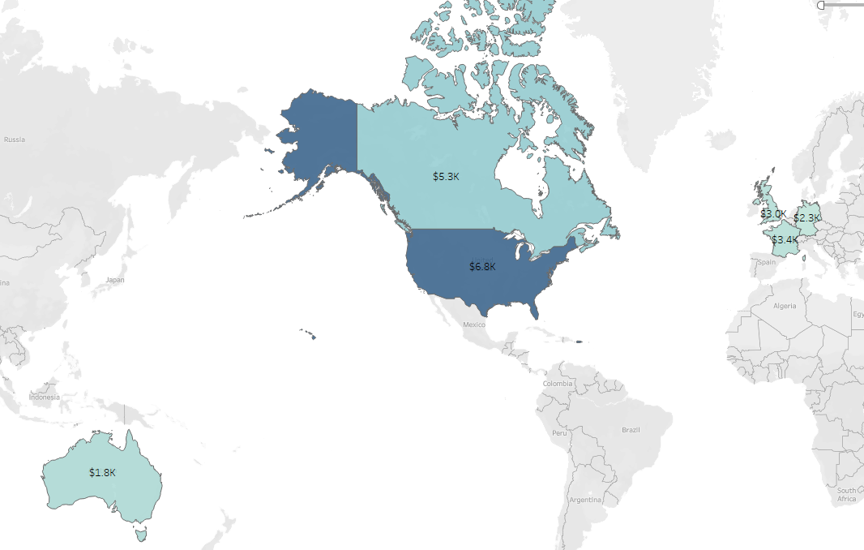
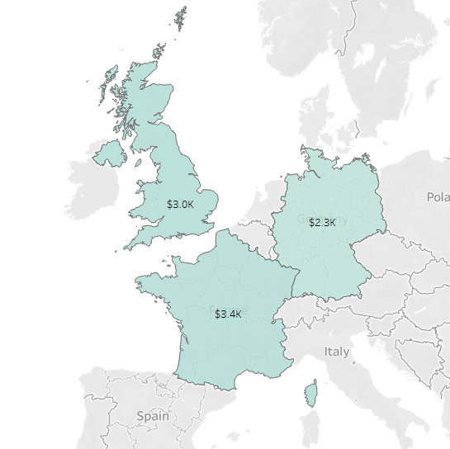
Which country is more profitable?

Slide 8
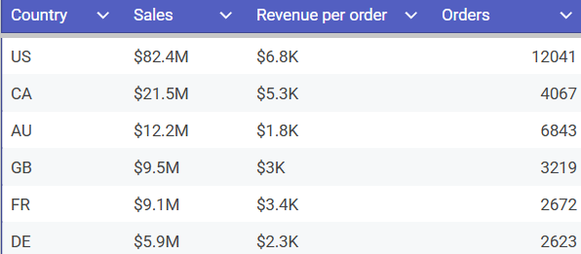
Sales and amount of Orders per country

Slide 9
Future plans
Social media + short videos
USA Market
Online Sales

Slide 10
Any Questions?

